Slide 1

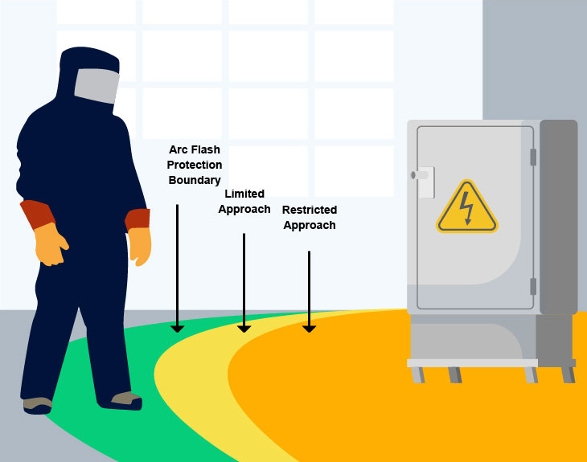
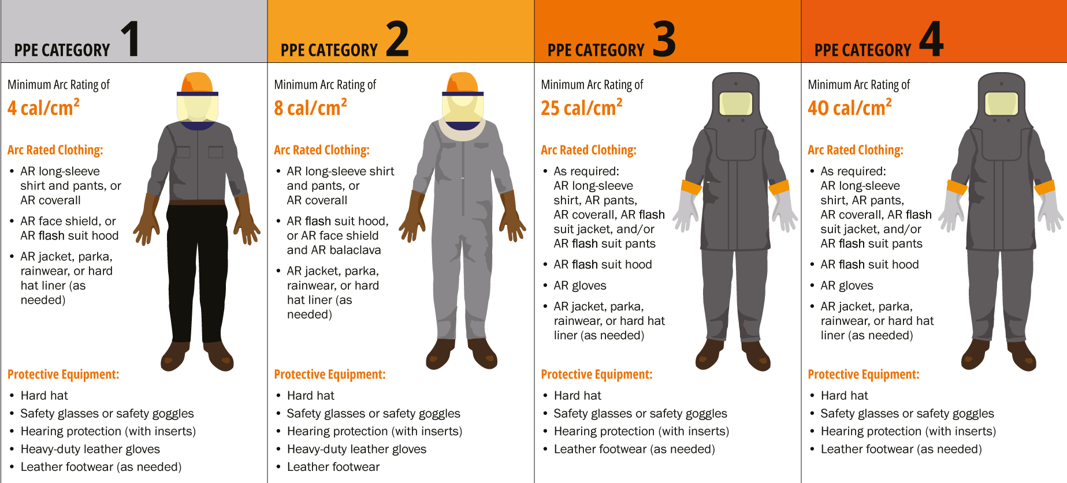
Arc flash study.
Arc flash studies are a critical aspect of electrical system safety, yet they are often overlooked or poorly executed. Inadequate assessments can lead to inaccurate incident energy levels, putting personnel at significant risk of severe injury or fatality. Achieving compliance with IEEE 1584-2018 ensures that arc flash hazards are accurately calculated, allowing for system design improvements to eliminate the hazard, implement engineering controls, adopt safe systems of work and correct selection of personal protective equipment. For HV and LV network owners and operators, sanctioning a thorough arc flash study is essential to maintaining a safe working environment and compliance to health and safety obligations.
An arc flash study should be undertaken in association with the following power system studies:
Short circuit study – A short circuit study enables the correct calculation of arcing current and allows for a comprehensive equipment evaluation to be performed.
Protection and coordination study – A protection study will provide the fault clearing time for a protective device during an arc flash event and allows for the reduction of arc flash energy through electrical system modifications.
An arc flash study requires a significant amount of data to be collected across the HV and LV electrical system. P&R Power Systems can undertake data collection of your HV and LV electrical network, ensuring a streamlined and efficient process.
The required data can often be split into four categories and will often represent a full and complete single line diagram of the electrical system.
Utility information
Impedance data
Protective device data
Equipment data
    At P&R Power Systems, we utilise industry-leading software to conduct precise and comprehensive power system studies, ensuring accurate arc flash calculations. Additionally, we provide expert design support to develop effective mitigation strategies for incident energy levels exceeding 8 cal/cm², enhancing workplace safety and compliance.

